Slide 1
NatSteel Visitor Safety Briefing

Slide 2
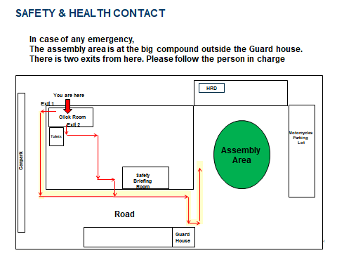

Slide 3
For your own safety:
Please ensure that you are being escorted by our
employees throughout the duration of your visit.

Slide 4


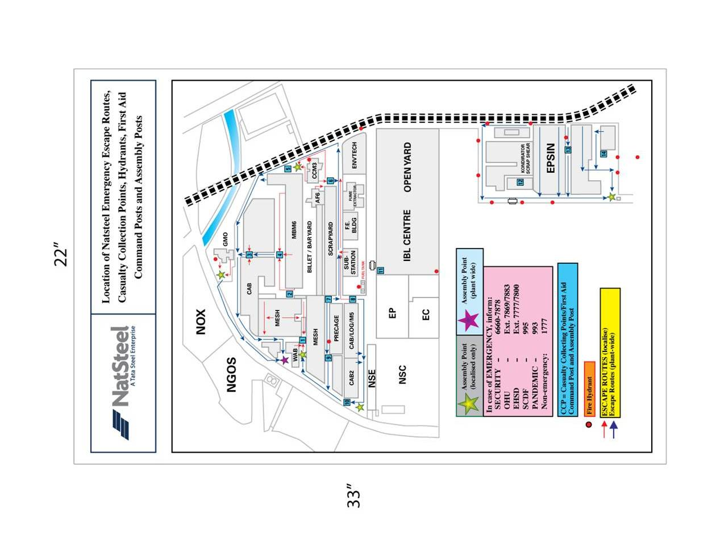
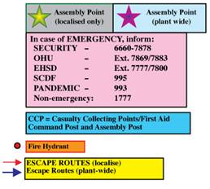


SAFETY FIRST
You are here
Respective Center Assembly Point

Slide 5
Hazards and Control Measures
Hazard | Risk | Control Measures
Lifting Operation | Hit by Falling Object | Implementation of Lifting Plan Designated Walkways Crane safety Devices Mandatory & Routine Inspections Operator Training
Forklift Operation | Hit by Moving Object | Designated / Elevated Walkways Demarcated work area Routine Inspection Competent Operators Regular retraining
Heavy Vehicle movement | Hit by Moving Object | Designated / Elevated Walkways Mandatory & Routine Inspections Competent Class 4&5 drivers Driver Safety Training & Communication Transport Safety Forum (Traffic Police)
Furnace Operation | Fire and Explosion | Routine Inspections Provision of Fire Fighting Equipment Competent Company Emergency Response Team Installation of Process critical Safety Devices Defining Restricted Work Zone
Material Handling | Working at Height | Provision of Lifeline and Anchor Points Mandatory Training on Work at Height Provision of Work at Height Personal Protective Equipments Provision and Usage of Movable step Platforms Usage of Boom lifts/Scissors lifts

Slide 6
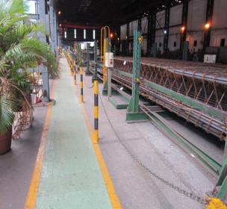
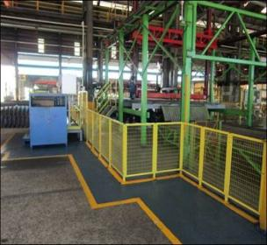
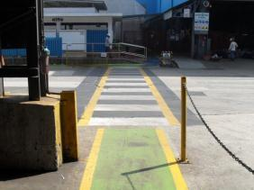



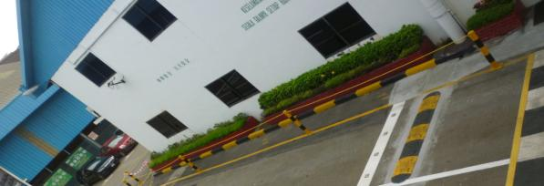
Use Safe Walkways & Pedestrian Crossings
For use by operators/internal staff
To be used by visitors
For locations where vehicle pathways intersect with walkways

Slide 7

Important Reminder:
ALL Visitors are required to hold onto hand-rails while using stairs

Slide 8

Important Reminder:
ALL Visitors are advised not to use mobile phones during the plant visit, designated mobile stations are available in the Factory

Slide 9

No Camera Please:
Visitors are not allowed to take photos during the
plant tour

Slide 10

No smoking:
Smoking is strictly prohibited at the workplace
Smoke only at designated locations

Slide 11

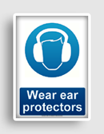
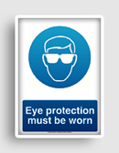
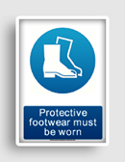
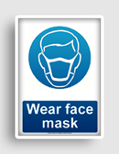
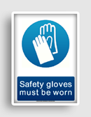
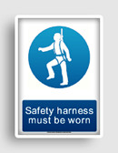
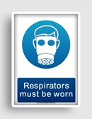
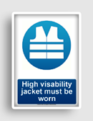
Please comply with our Personal Protective Equipment (PPE) Requirement
Basic Personal Protective Equipment
Work Related Personal Protective Equipment

Slide 12
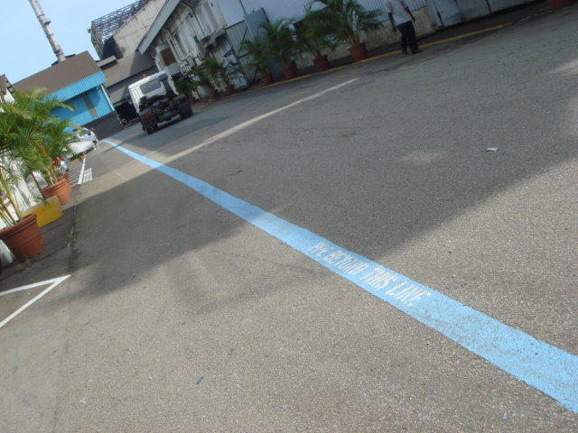
Personal Protective Equipment (PPE）
Please wear
1) Safety Helmet
2) Safety Glasses
3) Safety Shoes
4) Ear plugs
Once you want to cross the blue boundary line
Demarcation Line

Slide 13


Do Not ENTER into these Zones
BARRICADED Area DANGER Signs

Slide 14



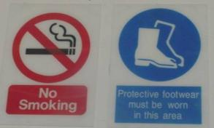

Please Look out for ALL WARNING Signs

Slide 15
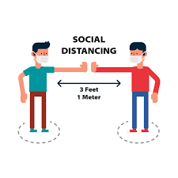
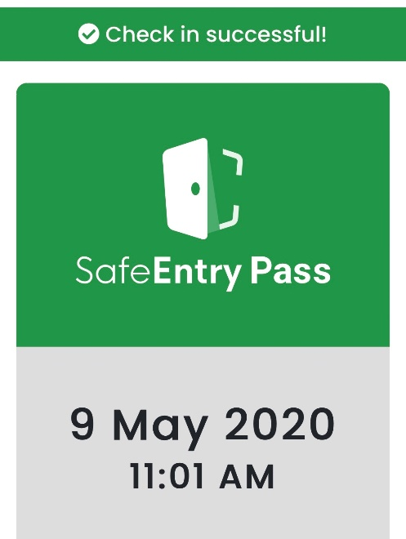
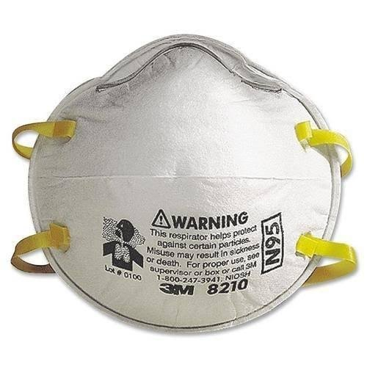
Safe Management Measures – COVID-19
Safe distancing (SD) – at least 1m apart at all times when practicable
Check in and out of workplace for SafeEntry QR and Natsteel declaration
Masks to be worn at all times
(N95 mask for MSP & MBM production areas, surgical/ cloth mask for control rooms/ rest rooms/ other places)
NATSTEEL HOLDINGS P/L

Slide 16

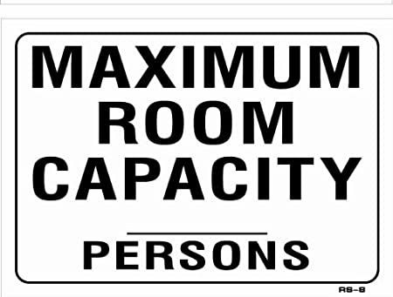

Safe Management Measures – COVID-19
Use sanitisers generously if unable to find wash basin
Remind co-workers if they are not following
Adhere to maximum room capacity
Ensure personal hygiene at all times – minimise touching face or eyes

Slide 17
Thank you for your kind attention.
Have a safe day ahead

